Slide 1

Chicago CRIMES DATASET
Team E -
Dakshayeni Bujunuru
Amit Ramjee
Sanisha Cheeti
Chethan Nemmadhi

Slide 2
AGENDA
Introduction of Problem / Synopsis
Data Description (ETL / Processing)
Exploratory Data Analysis
Data Processing Pipeline
Applied Models & Model Results
Decision Tree Classifier
XGBoost
Naïve Bayes
Random Forest
Conclusions

Slide 3


SYNOPSIS
Problem:
Crime in Chicago has a diverse range of criminal activity across different regions/districts, some which lead to an arrest, while others do not. Understanding what these crimes and where they are happening can help the city better manage their resources.
Objective
To predict the likelihood of an arrest based on certain columns such as the type of crime (“Primary Type”), (District/Community Area), Location Description. etc.
Analyze Chicago crime data patterns in recent years (2010-2022) to better understand the type of crimes happening in specific districts and if they led to an arrest by doing exploratory data analysis.

Slide 4


The DATA overview
Source: Chicago Data Portal
https://data.cityofchicago.org/Public-Safety/Crimes-2001-to-Present/ijzp-q8t2
Represents crime incidents from 2001 – Present, updated every 7 days
Owner: Chicago Police Department CLEAR (Citizen Law Enforcement & Reporting)
22 Columns & 7,921,843 rows of crime data

Slide 5
The DATA Details
ID (integer) – unique identifier
Case Number (text) – records police division #
Date (date/time) – date which incident occurred
Block (text) - partially redacted address where the incident occurred
IUCR (text) - Illinois Uniform Crime Reporting code
Primary Type (text) – parent description of crime
Description (text) – child description of crime
Location Description (text) – location where incident occurred (school, airport, alley, etc)
Arrest (boolean) – if an arrest was made
Beat (text) – police geographic area, 3-5 result in a police sector, and make up a district
District (text) – indicates police districts
Ward (text) – city of council district, changes
Community Area (text) – fixed geographic region, static boundaries, 77 total
FBI Code (text) – classification of crime outlined by FBI
X Coordinate (number)
Y Coordinate (number)
Year (Number) – Year in which incident occurred
Updated On (Date & Time) – when record last updated
Latitude (number)
Longitude (number)
Location (location) – for maps, combines longitude and latitude

Slide 6
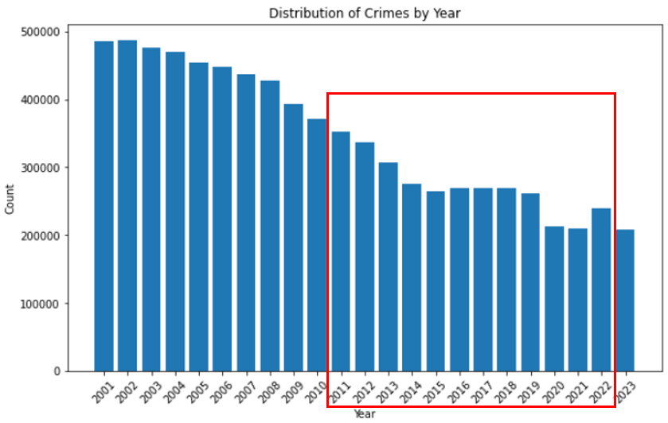
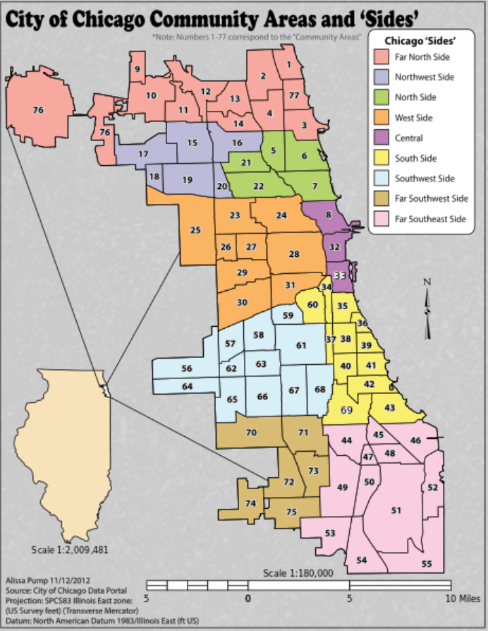
The DATA Pre-PROCESSING / ETL
Tools
Used Databricks Premium via Google Cloud Platform to run ML tests on separate clusters for nodes
Defined Sample Sizes by Year Range
Sample 1 : 2018 – 2022
Sample 2 : 2014 – 2022
Sample 3 : 2010 - 2022
ETL
Data extracted as CSV and loaded in S3 Amazon storage
Reduce Data Size
Limit data to only recent years 2010 – 2022
Missing Values
Addressed Nulls via for the following columns (43K rows or 1.2% of the data):
Latitude, Longitude, Ward, Community Area, District, X Coordinate
Location description filled with nulls with ‘Other’
Address duplicates – all unique, none
Data Type Conversions
Date (date & time) – convert into date column and time columns (hh:mm:ss)
Feature Enablement - Date, Month, Day of Week, Hour, Created Day (6am-6pm) and Night

Slide 7
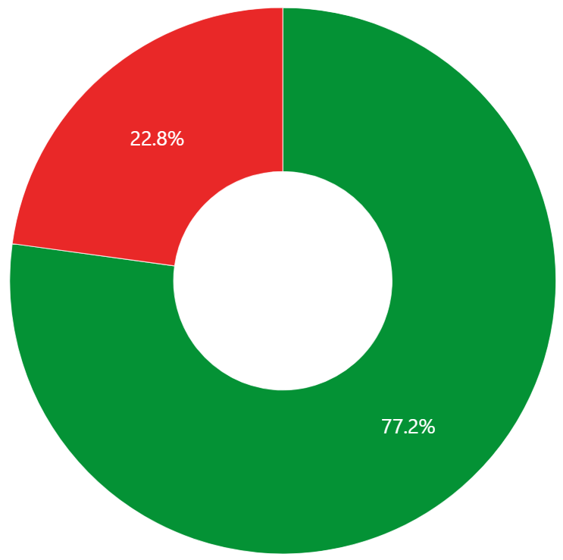
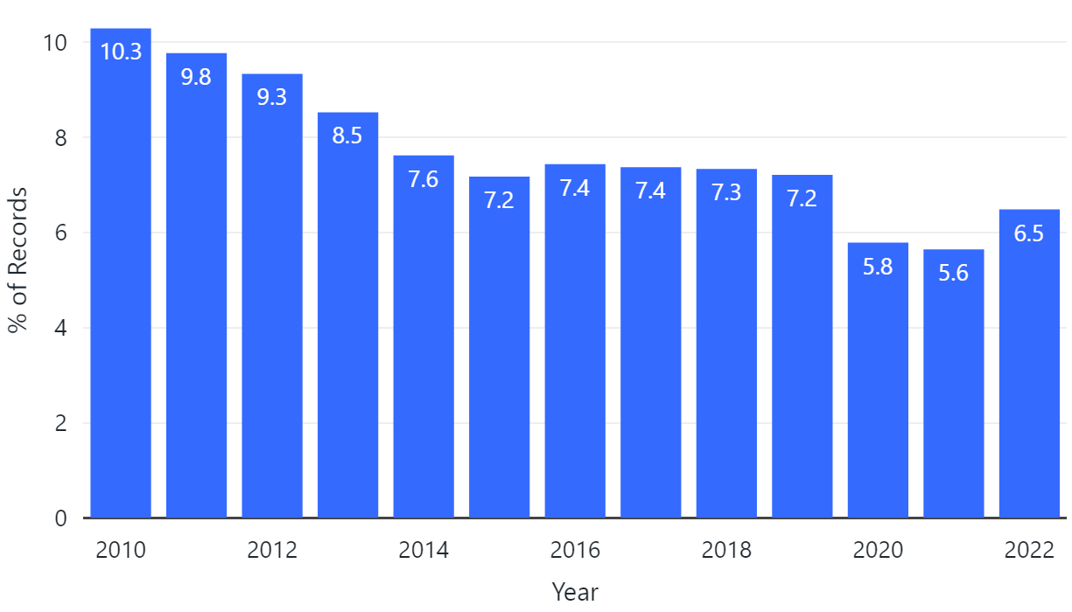
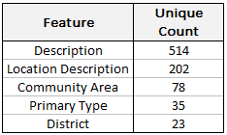
Exploratory Data analysis
Data from 2010-2022 represents 45.9% of total data (3,636,386 rows)
Imbalanced 22.3% of Crimes from 2010-2022 resulted in an Arrest
Arrest
% of Crime of Dataset
No Arrest
Crimes reported in future years decreased

Slide 8
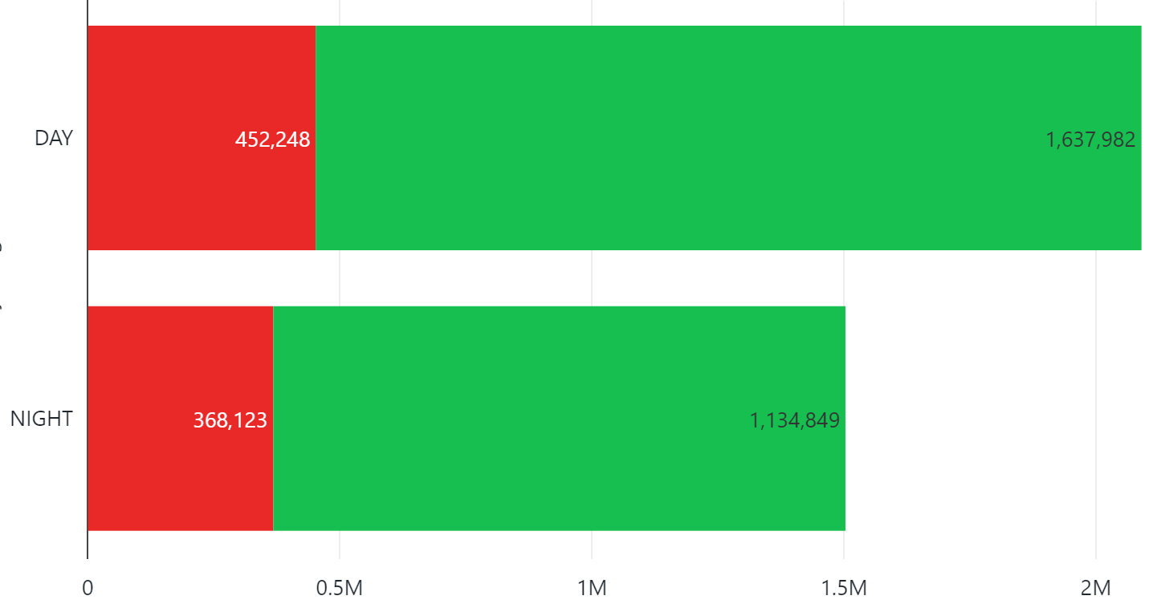
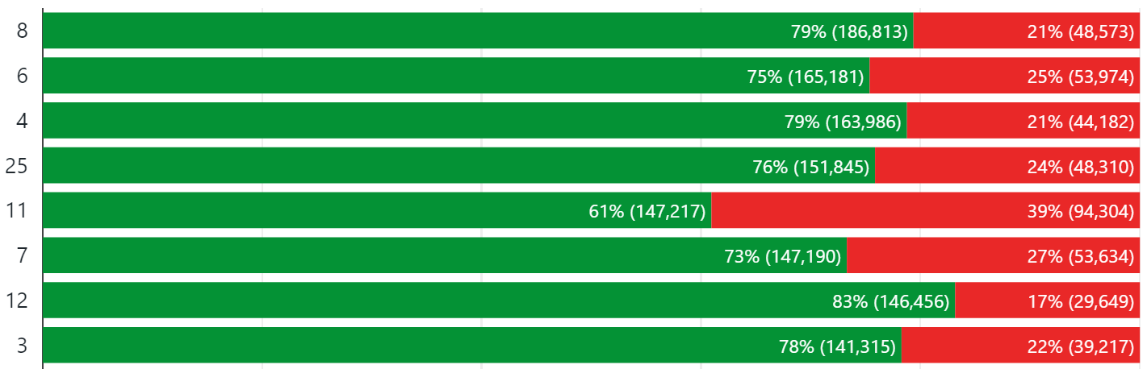

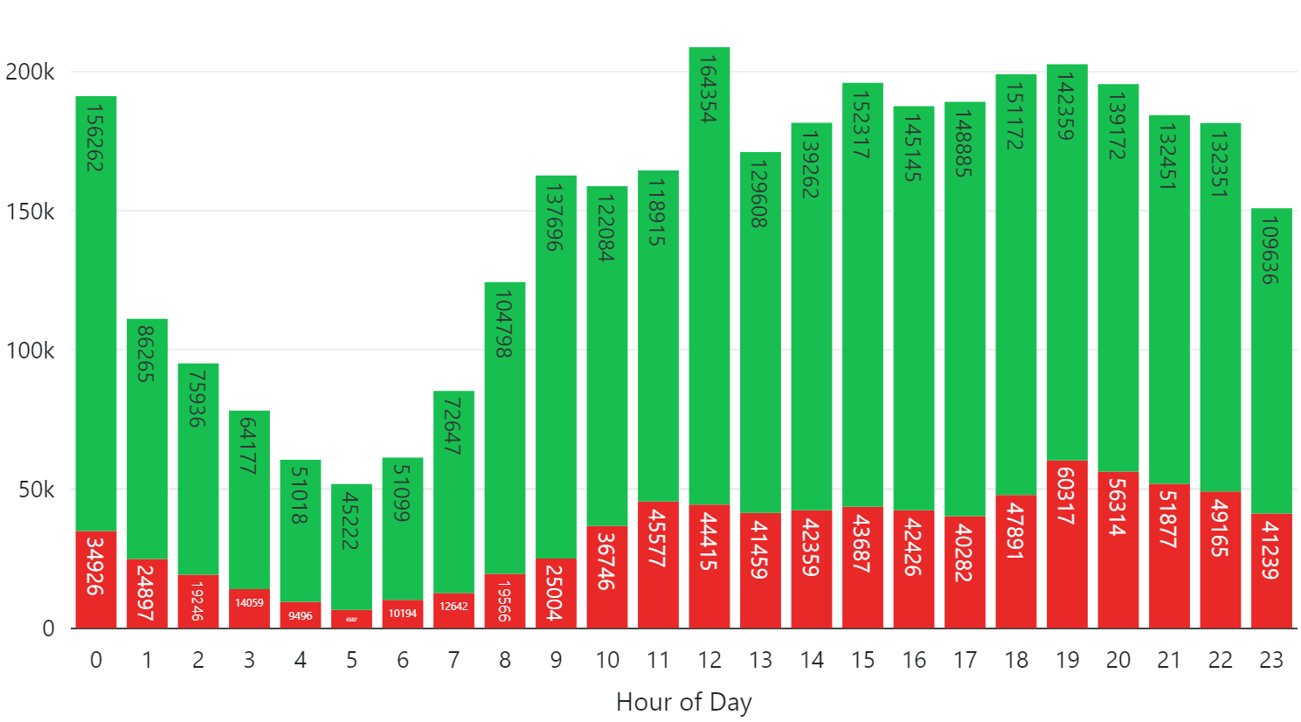
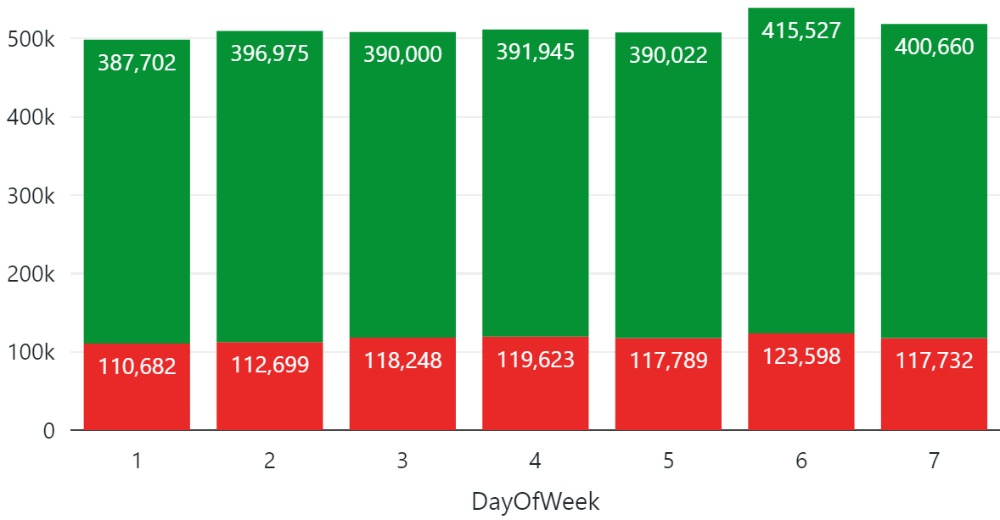
Exploratory Data analysis
Day vs. Night
24%
Top 8 Crime Districts
Day
22%
Night
Crimes by Day of Week
Crimes by Time of Day
Sun
Mon
Tues
Wed
Thur
Fri
Sat

Slide 9
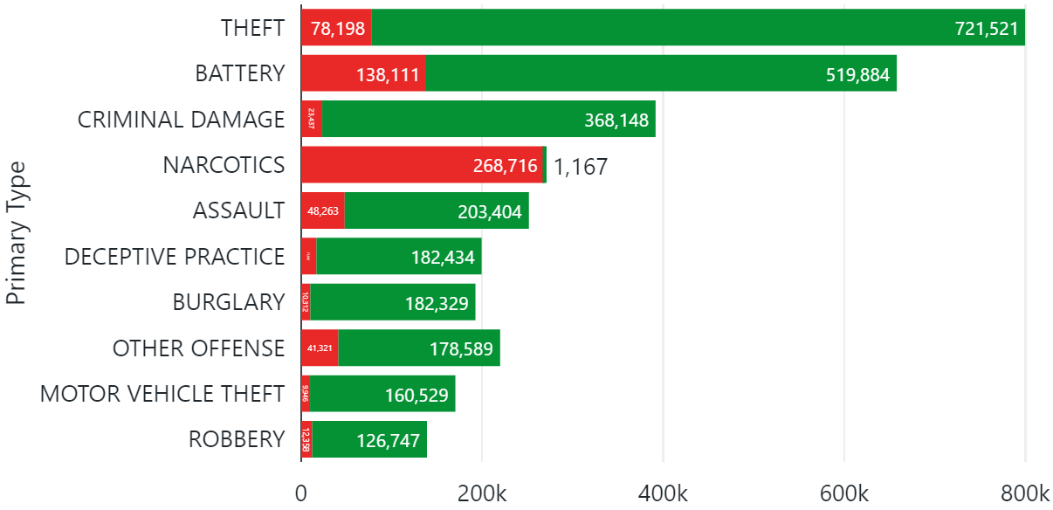
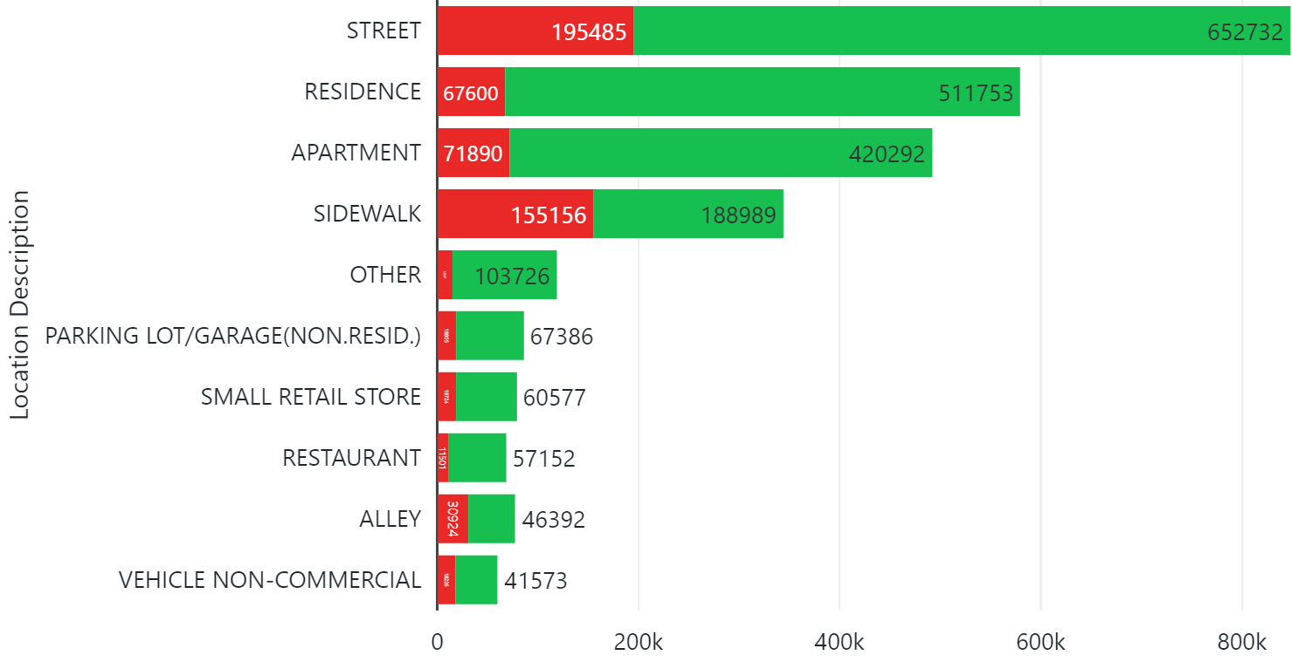

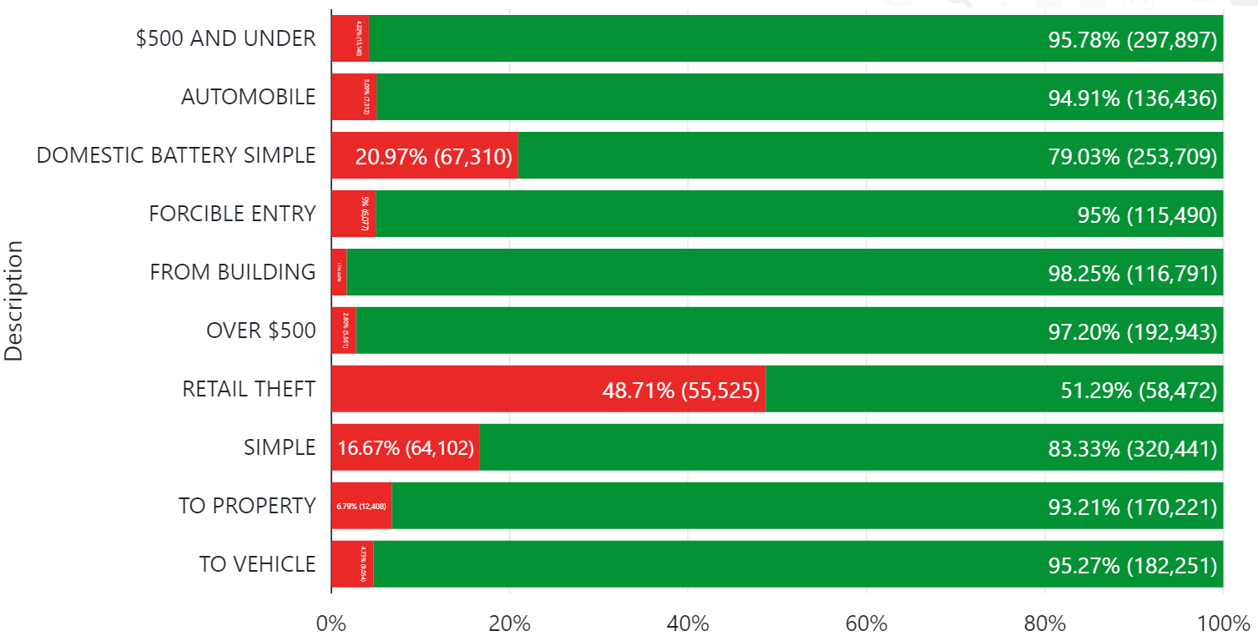
Exploratory Data analysis
Top 10 Primary Types of Crime
Top 10 Crime Locations

Slide 10
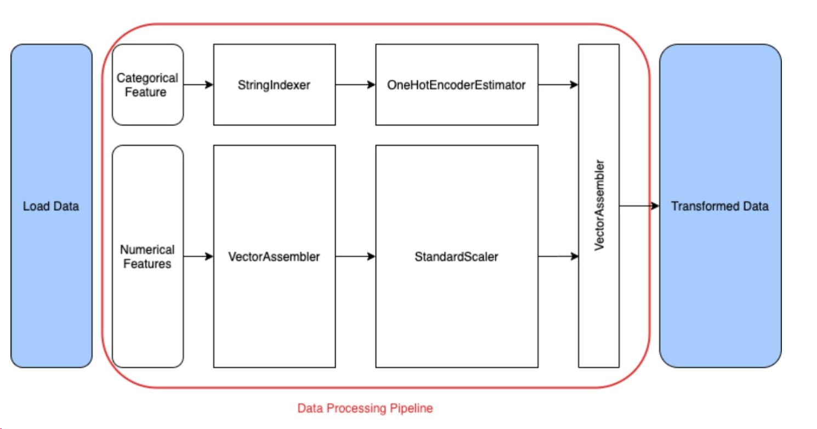
Data Processing PipeLINE
Features used for ML modelling:
Categorical Features : Primary Type , Description, Location Description
Numerical Features : District, DayorNight, HourofDay, DayOfWeek
Boolean : Domestic, Arrest ( True : 1, false : 0)

Slide 11
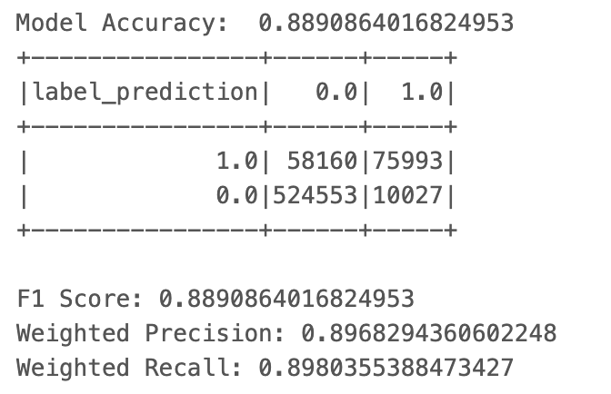
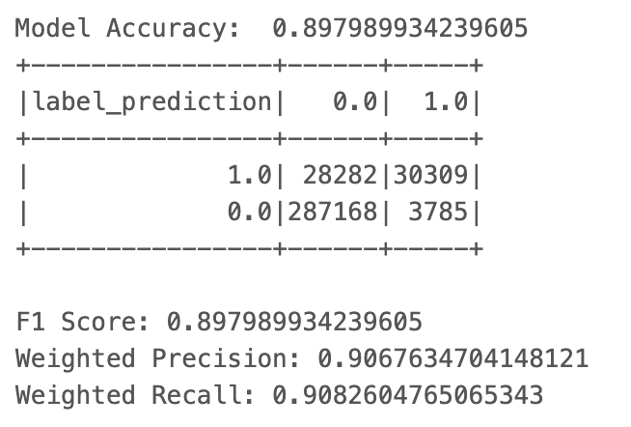
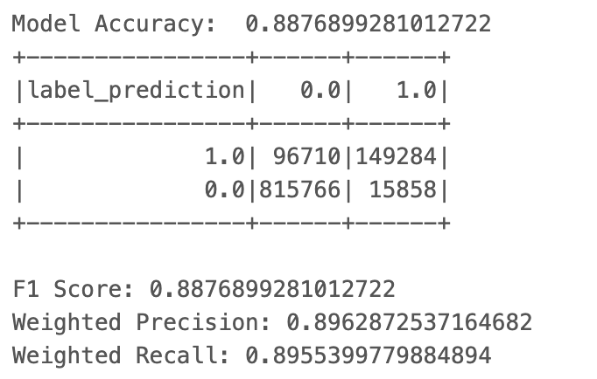
XG BOOST
2014-2022
XGBoost is a highly efficient and scalable machine learning algorithm that utilizes gradient boosting techniques, enhancing predictive performance by sequentially adding weak learners (decision trees), optimizing for both accuracy and computational speed, making it a versatile choice for a wide range of classification tasks.
Metrics:
2018-2022
2010-2022

Slide 12
XG BOOST
We have divided the data into 70% training and 30% for testing.
We got the best accuracy when the sampled data is 2018-2022(89.79%)
We have observed that as the no.of worker nodes increases the execution time decreases.
Time Taken for training vs no.of worker nodes
XG Boost | 2 nodes | 3 nodes | 4 nodes
2018-2022 | 14.03 | 12.29 | 11.03
2014-2022 | 22.84 | 20.49 | 19.18
2010-2022 | 39.41 | 38.27 | 34.58

Slide 13
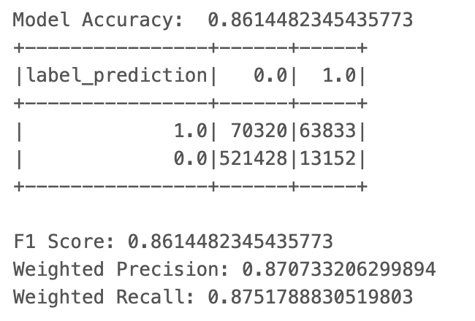
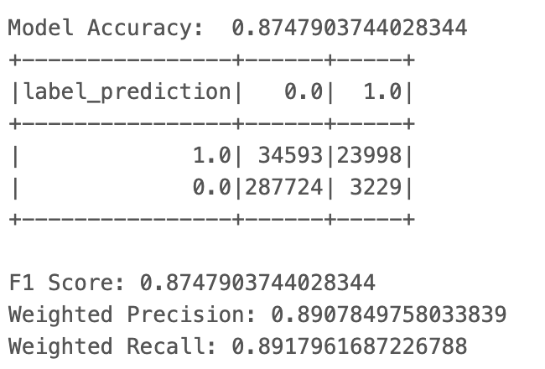
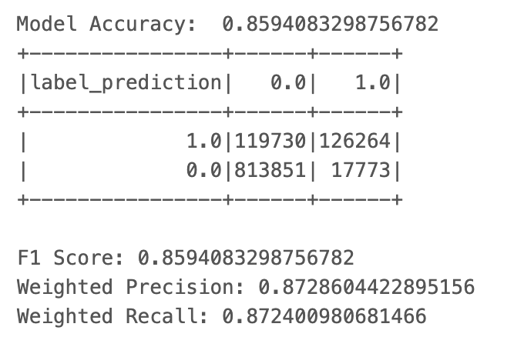
DECISION TREES
2014-2022
Decision trees are a type of machine learning algorithm used for both classification and regression tasks, characterized by their tree-like model of decisions and possible outcomes.
They are intuitive and easy to interpret, as they mimic human decision-making processes by splitting data into branches based on feature values.
Metrics:
2018-2022
2010-2022

Slide 14
DECISION TREES
We got the best accuracy when the sampled data is 2018-2022(87.47%)
As the same trend, We have observed that as the no.of worker nodes increases the execution time decreases.
Time Taken for training vs no.of worker nodes
Decision Trees | 1 node | 2 nodes | 3 nodes | 4 nodes
2018-2022 | 13 | 7.55 | 5.56 | 4.51
2014-2022 | 20.51 | 10.16 | 6.71 | 5.63
2010-2022 | 27.39 | 13.75 | 9.22 | 7.34

Slide 15
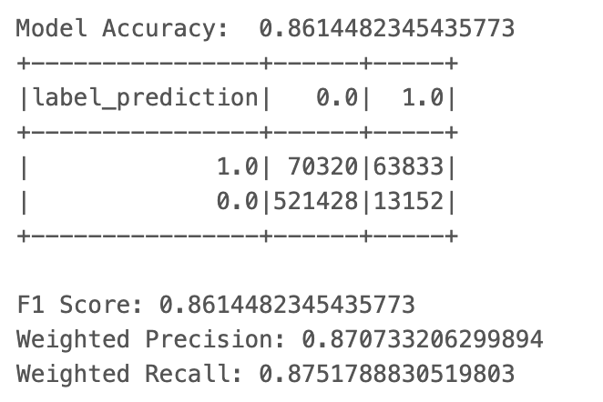
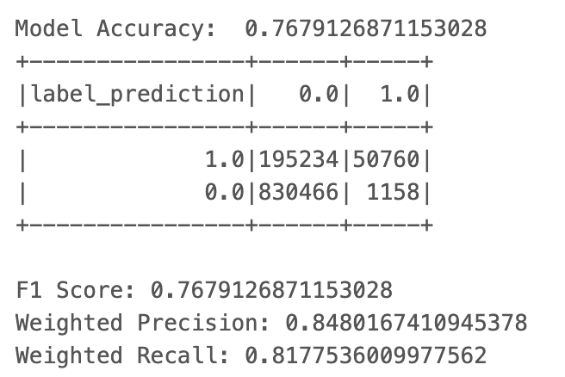
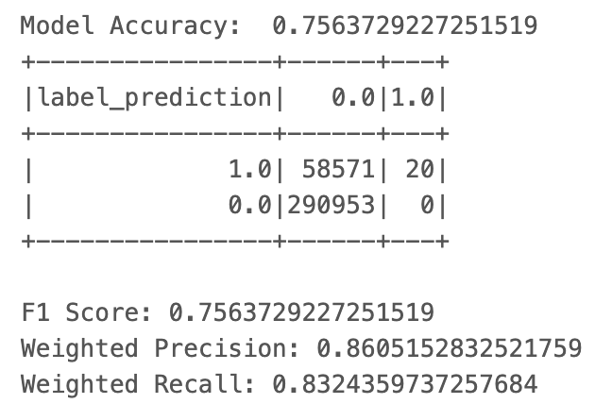
Random Forest
2014-2022
Random Forest is an ensemble learning technique that combines multiple decision trees to improve prediction accuracy and prevent overfitting, making it more robust than individual decision trees.
It operates by creating a multitude of decision trees during training and outputting the class that is the mode of the classes (for classification)
Metrics:
2010-2022
2018-2022

Slide 16
Random Forest:
We got the best accuracy when the sampled data is 2014-2022(86.14%)
As the same trend, We have observed that as the no.of worker nodes increases the execution time decreases.
Time Taken for training vs no.of worker nodes
Random Forest | 1 node | 2 nodes | 3 nodes | 4 nodes
2018-2022 | 13.22 | 8.3 | 6.23 | 5.1
2014-2022 | 21 | 10.01 | 6.46 | 5.93
2010-2022 | 27.25 | 12.79 | 8.37 | 6.96

Slide 17
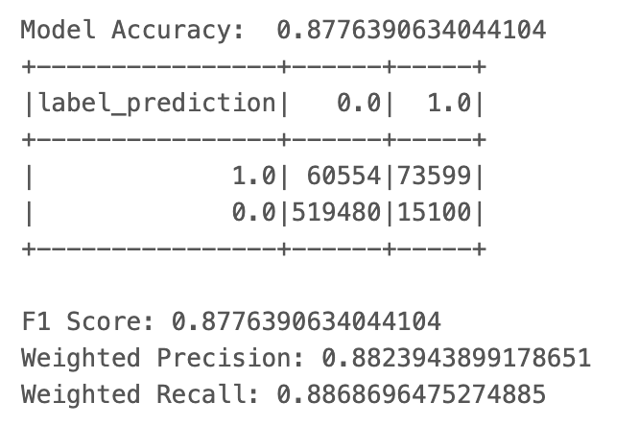
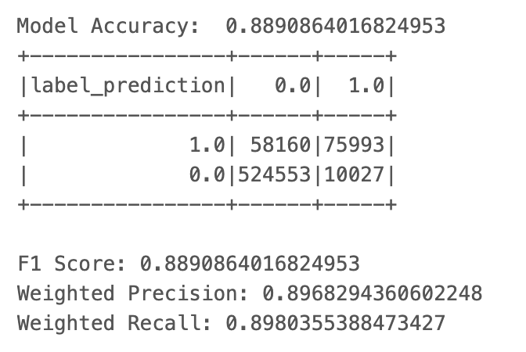
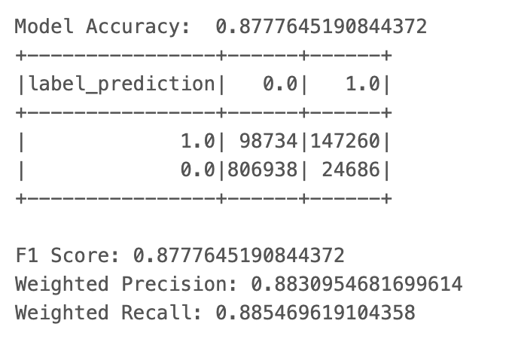
NAÏVE BAYES
2014-2022
Naive Bayes is a probabilistic classification algorithm based on Bayes' theorem, employing a simple yet effective assumption of feature independence, making it computationally efficient
Metrics:
2018-2022
2010-2022
Notes:
Recall (Sensitivity): The ratio of correctly predicted positive observations to all the actual positives.
Area Under the ROC Curve (AUC-ROC): Measures the true positive rate (recall) against the false positive rate at various thresholds.
Log Loss (Logistic Loss): Measures the performance of a classification model where the prediction is a probability value between 0 and 1.

Slide 18
NAÏVE BAYES
We got the best accuracy when the sampled data is 2018-2022(88.90%)
As the same trend, We have observed that as the no.of worker nodes increases the execution time decreases.
Time Taken for training vs no.of worker nodes
Naïve Bayes | 1 node | 2 nodes | 3 nodes | 4 nodes
2018-2022 | 11.87 | 6.56 | 5.1 | 3.71
2014-2022 | 14.27 | 7.61 | 5.74 | 4.74
2010-2022 | 17.61 | 8.64 | 5.96 | 5.42

Slide 19
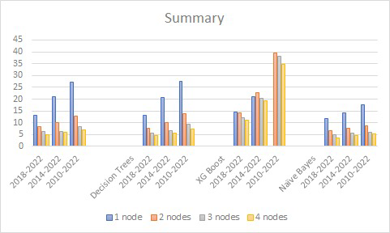
Conclusion
We analyzed 4 ML algorithms– Decision Trees, Random Forest, XG Boost and Naïve Bayes
Runtime decreased with the increase in number of nodes
Runtime increased with increase in amount of data
Among all the implemented algorithms, XG Boost performed well compared to others as it has highest accuracy of ~89 to ~90 percent based on the percentage of dataset.
Notes:
Training dataset and Test dataset

Slide 20

Thank you

